Slide 1


Dev10 Capstone project
Garrett Becker

Slide 2
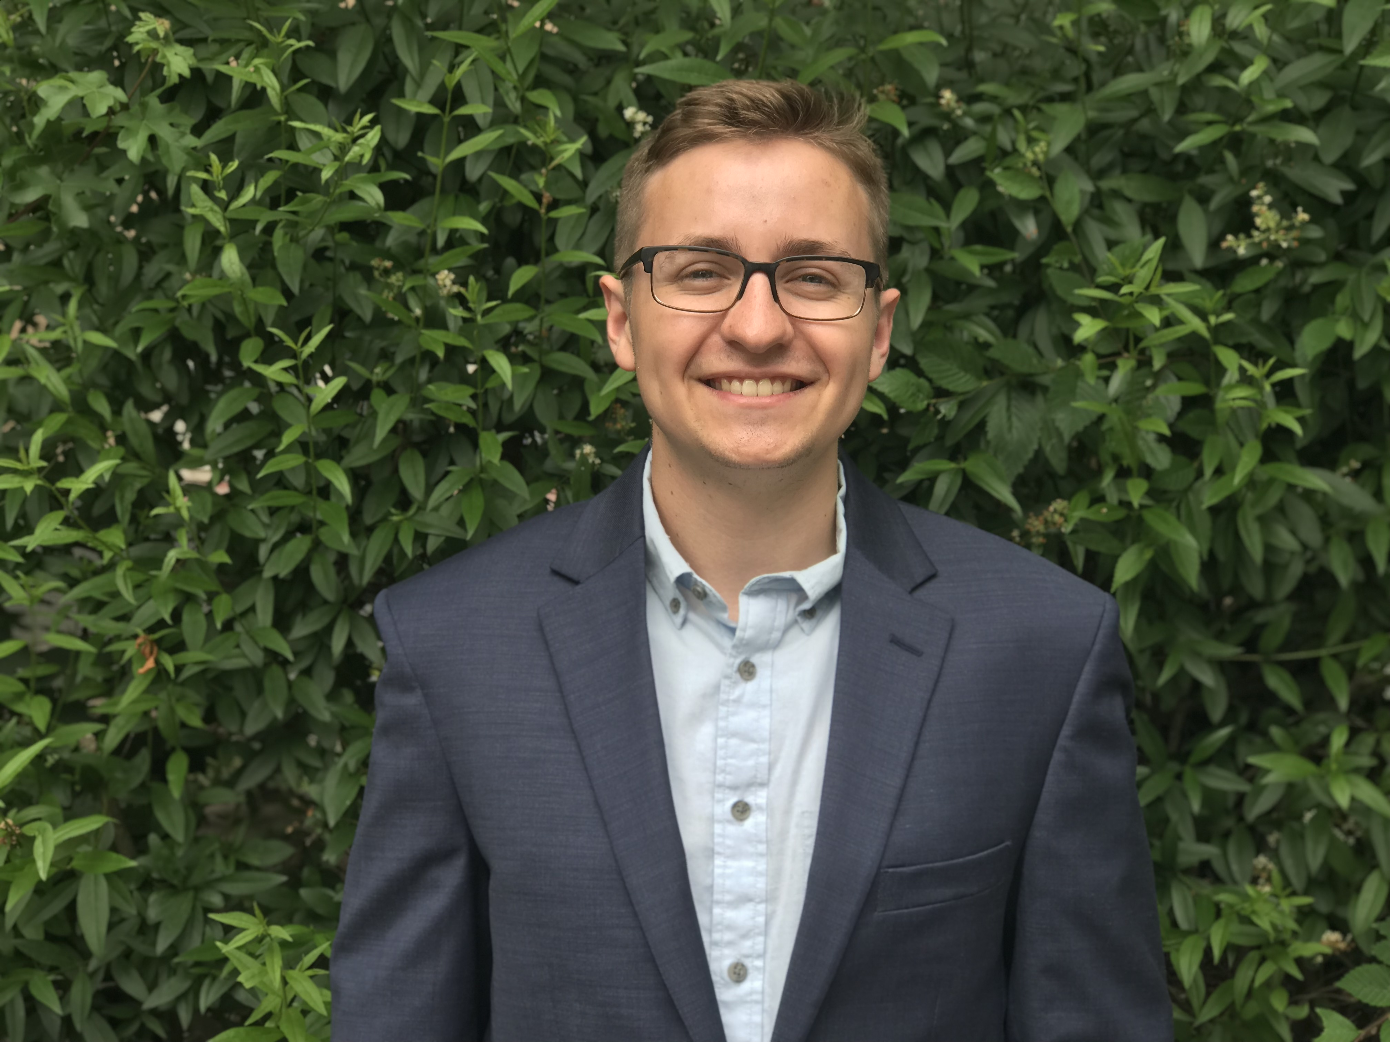
About Me
Background
Industrial Engineering degree from NC State University
Why Dev10?

Slide 3
Project overview
Overview

Slide 4
DEMO

